Slide 1
The History of Operating Systems
Marko Zivkovic
Computer Science Department
CS561
Illinois Institute of Technology 2014

Slide 2
What is an Operating System?
“An operating system (OS) is a collection of software that manages computer hardware resources and provides common services for computer programs. “
- Wikipedia

Slide 3
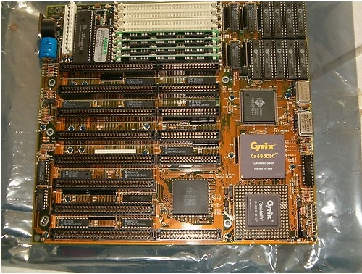
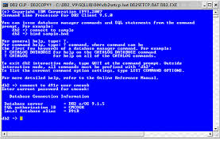
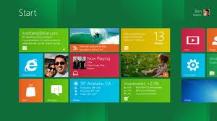
Why do we need Operating Systems?
We have hardware, but how to control it?
Mainframe computers
Hardware – Command Line – Graphical User Interface

Slide 4
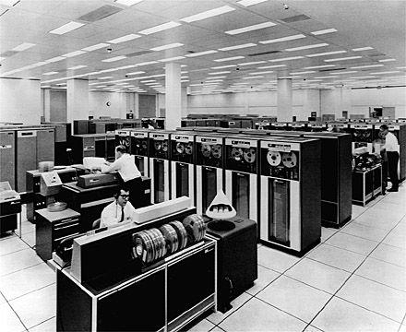
Where everything started?
Mainframes (1950)
Primitive conceptions of Operating Systems
Punching Cards (1725)
Magnetic Tapes (1950)
Programs “Done or Crash”
Alan Turning
IBM 7090 – Mainframe Computer

Slide 5
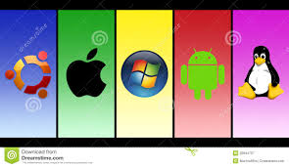
First Real Operating System is ?
GM-NAA I/O, produced in 1956 by General Motors Research Division
System/360 computers with OS/360 and DOS/360
Operating System blossom
Scope, MACE, Kronos, EXEC, MCP, etc. (1960 -1967)

Slide 6
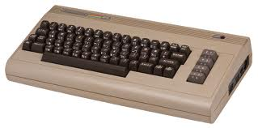
More Operating Systems
Plato System in late 1970s (Real Time Chat)
Multics MIT (Security Levels)
UNIX OS, Bell Labs (1960, portable, in C, main OS for Bell Labs)
MOS home computers, 8bit
Commodore 64, Atari, Apple II Series, Spectrum 1980 (8 bit home comps)
Geos, CP/M (The most successful at that time)

Slide 7
The invention of Microprocesors
Inexpensive, Interchangeable components
Widespread and Start of PC era
MSDOS 1.0 – Microsoft and IBM-PC (1981) 16 bit,
X Window OS – Unix like (since cost of components deceased) GUI
Widespread of GUI ( Apple, Windows, Amiga, Atari )
“Windows Empire” started 1989

Slide 8
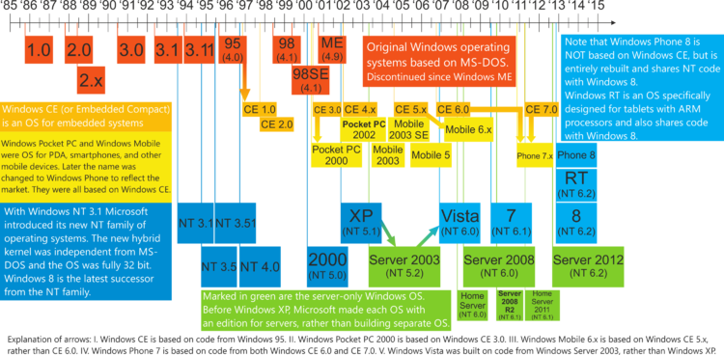
Windows Operating Systems

Slide 9
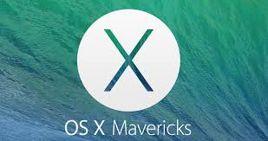
Apple Operating Systems
OS X Mavericks -2013

Slide 10
Unix Operating Systems
Ken Thompson, Dennis Ritchie -- Bell Labs 1969
4TH edition in C, portable OS 1973
Mostly used in Bell Labs by 1975
Solaris, AIX, XP-UX
Internet, Server, Networks
Apple Mac OS certified to Unix 03 Kernel

Slide 11
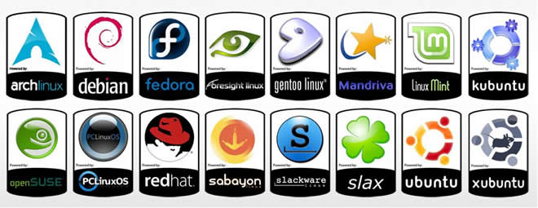
Linux Operating Systems
Linus Torvalds created MINIX 1991
Free, Open Source
First Linux Kernel September 1991
Small and medium size operations

Slide 12
May I have your questions?

Slide 13
Sources:
http://www.diffen.com/difference/Linux_vs_Unix
http://www.unix.org/what_is_unix/history_timeline.html
http://en.wikipedia.org/wiki/History_of_Mac_OS
http://en.wikipedia.org/wiki/Timeline_of_Microsoft_Windows
http://inventors.about.com/od/computersoftware/a/Putting-Microsoft-On-The-Map.htm
http://en.wikipedia.org/wiki/Punched_card
http://en.wikipedia.org/wiki/History_of_operating_systems#The_mainframe_era

Slide 14
The End of Presentation
The History of Operating Systems
Marko Zivkovic
Computer Science Department
CS561
Illinois Institute of Technology 2014

